Slide 1
Question-4
Oct 3
Dejan

Slide 2
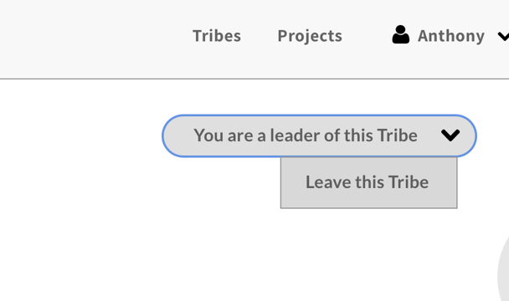
Q4: Post a discussion
Q4: I think the owner of tribe cannot leave the tribe.
So I think this screen cannot exist with ‘You are a leader of this tribe’ label and ‘leave this tribe’ button.
Am I right?

